Slide 1

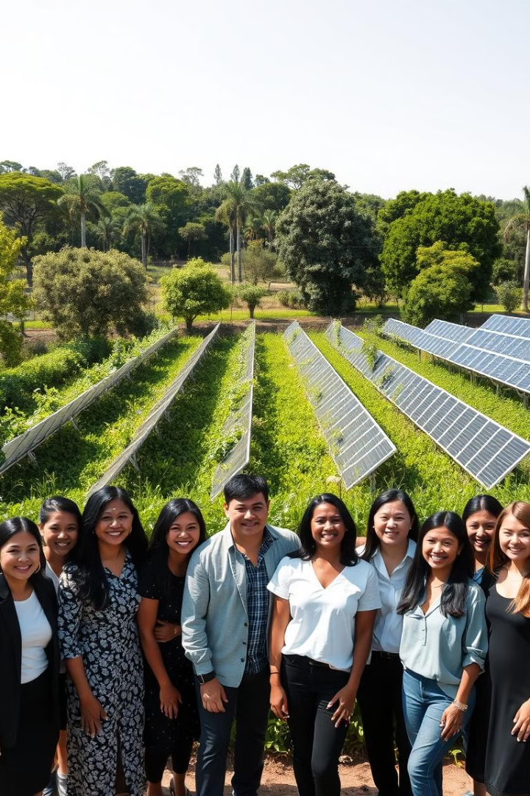

MyMate
A Professional Networking Platform for Students and Early-Career Professionals
Group Members:
Abhinav Kajla
Ashutosh
Divyanshi Bhadauria
Divyansh Chauhan
Mentor: Mr. Shish Pal (Assistant professor)
Notes:
1

Slide 2
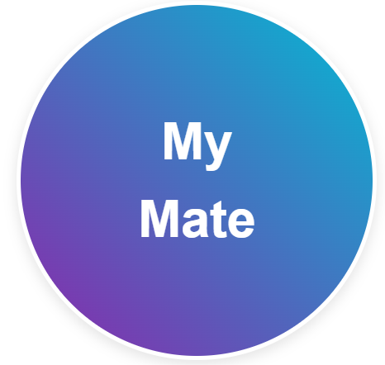
Project Abstract
Overview
Key Objectives
Approach
MyMate is a professional networking platform tailored for students and early-career professionals. Inspired by the goals of connecting individuals in academics and industry, MyMate fosters a community where users can share experiences, access valuable learning resources, and build meaningful connections. Unlike traditional networking platforms, MyMate focuses on mentorship, providing juniors the opportunity to learn from seniors while also enabling seniors to expand their professional networks.
Facilitate Professional Networking
Enable Knowledge and Resource Sharing
Promote Real-Time Communication
Ensure Security and Data Privacy
Design for Scalability and Performance
Backend Development and Security
Frontend Development and UI/UX Design
Database Management and Optimization
Quality Assurance and Testing
Collaboration and Feedback Loop
Presentation and Deployment
Notes:
2

Slide 3

Project Goals and Objectives
Enable Knowledge Sharing and Collaboration
1
Facilitate easy sharing of resources, insights, and professional content through features like post creation, liking, sharing, and saving.
Build a Secure, Scalable Networking Platform
2
Develop a professional networking site that enables students and early-career professionals to connect, learn, and grow within a secure environment.
Encourage Professional Relationships and Growth
3
ntroduce a follow/unfollow system that allows users to curate their network and stay connected with peers and mentors, keeping them updated on relevant activities and opportunities.
Notes:
3

Slide 4
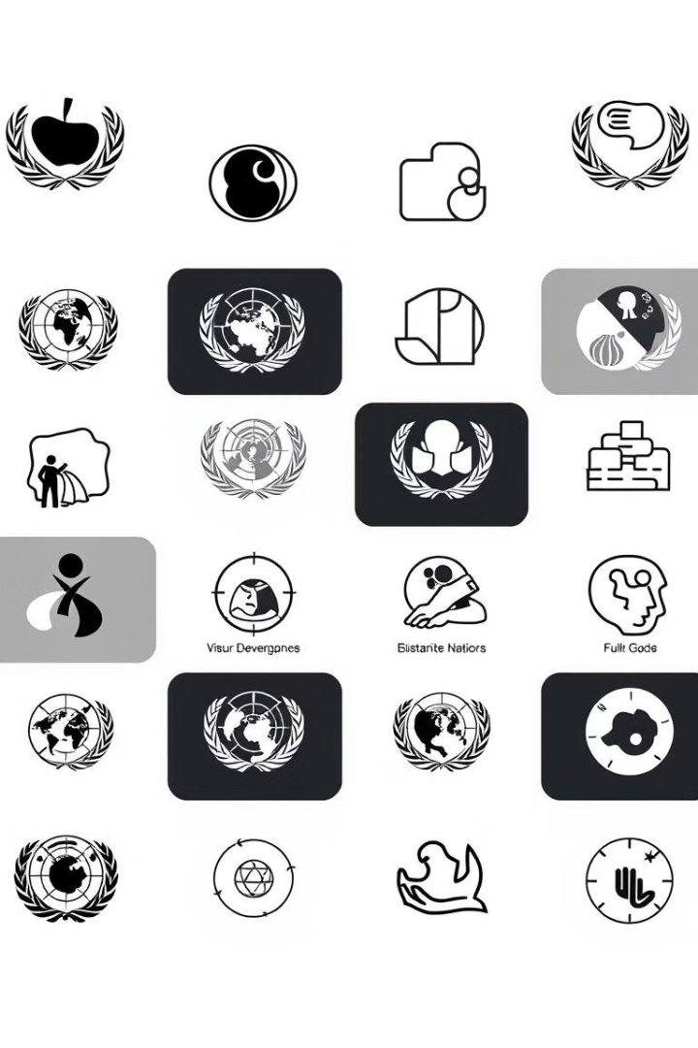
Alignment with UN Sustainable Development Goals (SDGs)
SDG 4: Quality Education
SDG 8: Decent Work
and Economic Growth
Promoting Lifelong Learning
Enhancing Employability
SDG 10: Reduced
Inequalities
SDG 17: Partnerships for the Goals
Expanding Access to Opportunities
Building Strong Connections
Notes:
4

Slide 5

Methodology and Approach
UI/UX Design
Feasibility study
Coding Phase
Database Design
User Authentication
Testing
Deployment
Notes:
5

Slide 6
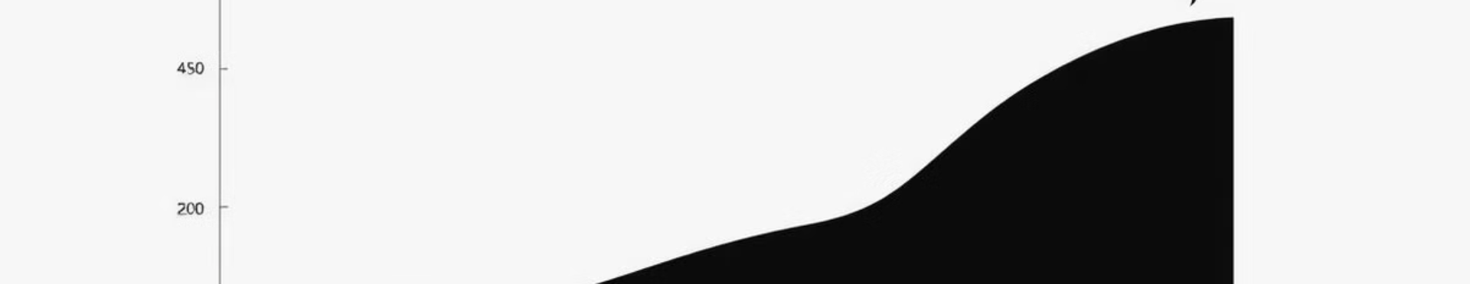



Expected Outcomes and Impact
Enhanced Professional
Networking for Students
and Early-Career
Professionals
Resource Sharing and
Learning Community
Empower users to use
React-AWS certified
Notes:
6

Slide 7

Key Project Deliverables
Functional Minimum Viable
Product
User Authentication System
Real-Time Chat Feature
Post and Interaction Management
User Notifications System
Presentation Material for Project Showcase
Notes:
7

Slide 8

Next Steps
Refine User Interface and UX Based on Feedback
1
Review the UI design and make adjustments based on initial user feedback or usability testing results.
Prepare for Project Presentation and Demo
2
Develop presentation materials and a demo of key platform features, focusing on the technical architecture, core functionalities, and alignment with project goals and SDGs.
Deploy Platform and Set Up Monitoring
3
Deploy the application to a production environment (e.g., Heroku, Vercel) and set up monitoring to track performance, errors, and user activity.
Notes:
8

Slide 9
Conclusion
1
Professional Networking for Early-Career Development
2
Valuable Features for Learning and Collaboration
3
User-Centric, Accessible Design
4
Alignment with Sustainable Development Goals (SDGs)
5
Future Potential and Continuous Improvement
6
Prepared for Presentation and Growth
Notes:
9

Slide 10
Thank You
Notes:
10

